Slide 1
H20 Decomposition
Display Output Layout

Slide 2
Contents
Project Overview
Background
Goals & Purpose
Objectives
START-UP SEQUENCE
OPERATING
MAIN MENU
Setting Sub-Menu
END

Slide 3
PROJECT OVERVIEW

Slide 4
Background

Slide 5
Purpose & Goals

Slide 6
Objectives

Slide 7
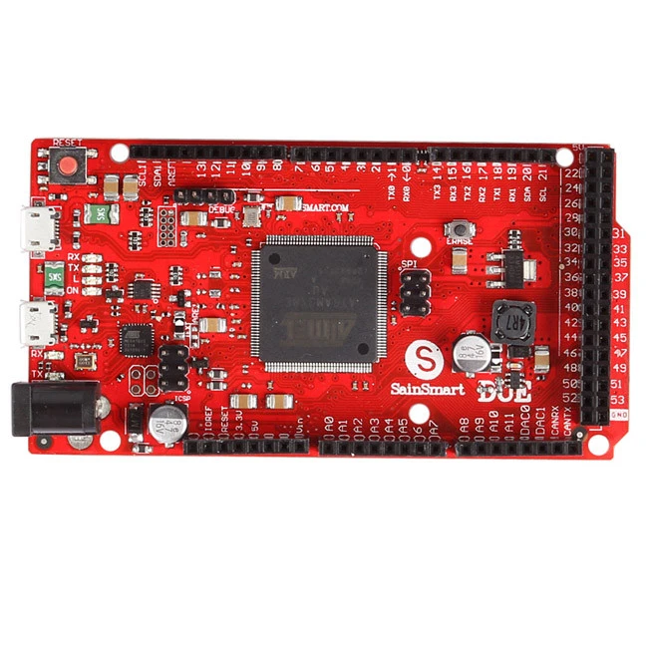
Micro Controller Board - Option: A
SainSmart Due Atmel SAM3X8E ARM Cortex-M3 board
The SainSmart Due is a microcontroller board based on the Atmel SAM3X8E ARM Cortex-M3 CPU (datasheet). It is the first SainSmart board based on a 32-bit ARM core microcontroller. It has
54 digital input/output pins (of which 12 can be used as PWM outputs),
12 analog inputs,
4 UARTs (hardware serial ports),
a 84 MHz clock,
an USB OTG capable connection,
2 DAC (digital to analog),
2 TWI, a power jack, an SPI header, a JTAG header, a reset button and an erase button.

Slide 8
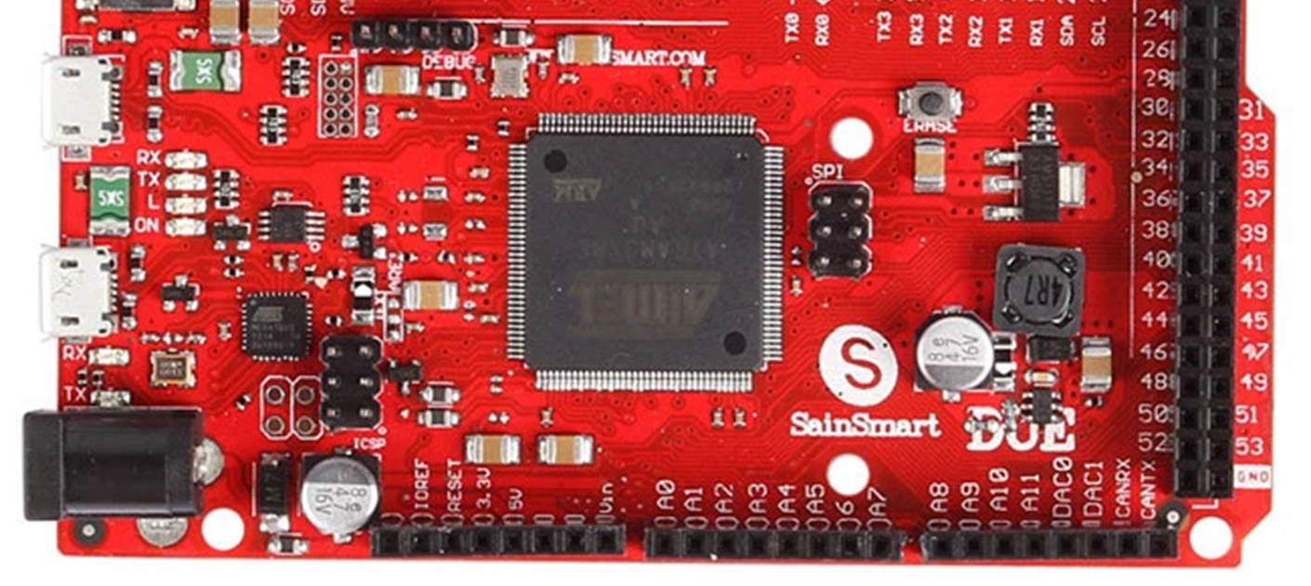
Micro Controller Board - Option: A (Pg. 2)
SainSmart Due Atmel SAM3X8E ARM Cortex-M3 board
Digital I/O Pin Assignments
1 |  | 11
2 |  | 12
3 |  | 13
4 | LCD_PIN_D0 [OUT] | 14
5 | LCD_PIN_D1 [OUT] | 15
6 | LCD_PIN_D2 [OUT] | 16
7 | LCD_PIN_D3 [OUT] | 17
8 | LCD_PIN_RS [OUT] | 18
9 | LCD_PIN_ENABLE [OUT] | 19
10 |  | 20

Slide 9
Micro Controller Board - Option: A (Pg.3 Cont’ed)
SainSmart Due Atmel SAM3X8E ARM Cortex-M3 board
Digital I/O Pin Assignments
21 |  | 31
22 |  | 32
23 |  | 33
24 |  | 34
25 |  | 35
26 |  | 36
27 |  | 37
28 |  | 38
29 |  | 39
30 |  | 40

Slide 10
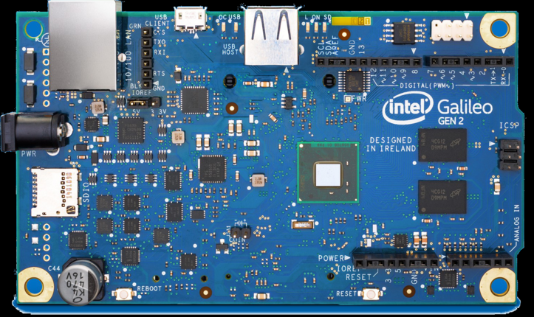
Micro Controller Board - Option: B
Intel® Galileo Gen 2 Development Board
Developer | Intel Corporation
Type | Single-board computer
Release date | 10 July 2014^{[4]}
Introductory price | US$79.90^{[5]}
Operating system | Linux
CPU | Intel Quark X1000 32-bit 400 MHz
Memory | 256 MB
Storage | Flash Memory 8M, EEPROM 8 kb, Micro SD card slot up to 32GB
Power | 15 W
Website | www.intel.com
https://www.intel.com/content/dam/support/us/en/documents/galileo/sb/intelgalileogen2prodbrief_330736_003.pdf
https://www.intel.com/content/dam/support/us/en/documents/galileo/sb/galileo_fabh_schem_120514.pdf

Slide 11
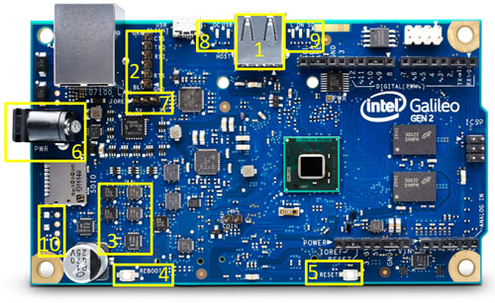
Micro Controller Board - Option: B (Cont’ed)
Intel® Galileo Gen 2 Development Board
Component Layout:
Intel® Galileo Gen 2 Board substituted the mini USB host port for a full-size USB host port.
FTDI Port has substituted the 3.5 mm jack.
Multiple multiplexers replaced the Cypress CY8C9540A.
The reboot is now found where the reset button was on the previous version on the bottom left side.
The reset isn't on the bottom right of the device where the reboot was located in the previous version.
The power supply is a minimum of 7V, and maximum of 15V. Don't use the power supply of the previous version.
The IOREF pins are next to the Ethernet port.
LED for USB relocated and new OC LED.
New LED for Loading, ON and SD LEDs relocated.
Preset for installation of PoE module.
N.B: Other changes not showed in the image, JTAG is on the back side of the board.

Slide 12
SYNTAX & LIBRARIES
Section #1

Slide 13
Display Syntax
Symbols
Colours
?
Numeric
Character
*
Blue
Red
Input Field
Output Field

Slide 14
Icon Library
Arrow UP
Arrow Down
Select Icon
Special
Water Molecule
Pad Lock
Arrow Right
Arrow Left
Functions
Gate Frequency
Pulse Frequency
Feedback Voltage
Duty Cycle
Cursors

Slide 15
Icon Library (Cont’ed)
Functions
Gate Frequency
Pulse Frequency
Feedback Voltage
Duty Cycle

Slide 16
Icon Library (Cont’ed)
Cursors
Arrow Left
Arrow Right
Arrow UP
Arrow Down
Select Icon

Slide 17
Icon Library (Cont’ed)
Special
Water Molecule
Pad Lock

Slide 18
Start-up Sequences
Section No. 1A

Slide 19
Boot Loader Sequence
16x2 Monochrome LCD Display Layout
Boot Loader Screen
 |  |  | H | 2 | O |  | t | o |  | H | H | O
G | e | n | e | r | a | t | o | r |  | v | [MAJ] | . | [MIN] | [MIN] | [REL]

Slide 20
Boot Loader Sequence
Firmware version display description
[MAJ]
[MIN]
[REL]
Major (e.g. v1.XX?)
Minor (e.g. vX.15?)
Release Suffix (e.g. vX.XXc)

Slide 21
Start-up Sequence
Section No. 2B

Slide 22
Resonance Scanning Sequence
16x2 Monochrome LCD Display Layout
Frequency Scanning
 | S | C | A | N | N | I | N | G |  | R | A | N | G | E
 | * | * | * | . | * | * | ? | H | z |  |  | * | * | s

Slide 23
OPERATION
Section No. 2

Slide 24
Home Screen Functions
[@] Percentage Duty Cycle
[G] Gating Frequency
Resonant Frequency Locked
[P] Pulsing Frequency
[O] Feedback Voltage

Slide 25
Home Screen Layout
Home Screen
G | 0 | 0 | 9 | . | 9 | 9 | ? | H | z | @ | 0 | 9 | . | 9 | %
P | 0 | 0 | 9 | . | 9 | 9 | ? | H | z |  | O | 9 | . | 9 | V

Slide 26
MAIN MENU
Section No. 3

Slide 27
Menu Options
2. SETTINGS
3. Exit
1. Resonance Scan
MAIN MENU
Re-scans Resonance frequency
Test Display, Keypad and LED Functions
Go back to Home Screen
Pressing ‘Select’ key launches the this menu.

Slide 28
Main Menu Layout
Main Menu Splash
 |  |  |  |  |  | M | A | I | N
 |  |  |  |  |  | M | E | N | U

Slide 29
Main Menu Layout
Main Menu - Top
 |  | < | M | A | I | N |  | M | E | N | U | >
 | 1 | : | R | E | S | C | A | N |  | R | E | S | . | . | .

Slide 30
Main Menu Layout
Main Menu - Middle
 |  | < | M | A | I | N |  | M | E | N | U | >
 | 2 | : | S | E | T | T | I | N | G | S

Slide 31
Main Menu Layout
Main Menu - Bottom
 |  | < | M | A | I | N |  | M | E | N | U | >
 | 3 | : | E | x | i | t

Slide 32
SETTINGS SUB-MENU
Section No. 4

Slide 33
SETTINGS MENU - Layout
Settings Menu - Top
 |  | < | 2 | . | S | E | T | T | I | N | G | S | >
 | 1 | : | O | p | t | i | o | n | ?

Slide 34
SETTINGS MENU - Layout
Settings Menu - Middle
 |  | < | 2 | . | S | E | T | T | I | N | G | S | >
 | ? | : | D | e | b | u | g | i | n | g

Slide 35
SETTINGS MENU - Layout
Settings Menu - Bottom
 |  | < | 2 | . | S | E | T | T | I | N | G | S | >
 | ? | : | B | a | c | k

Slide 36
THE END
THANK YOU!

